Slide 1
Lecture 8
Mechanisms of Enzyme Action

Slide 2
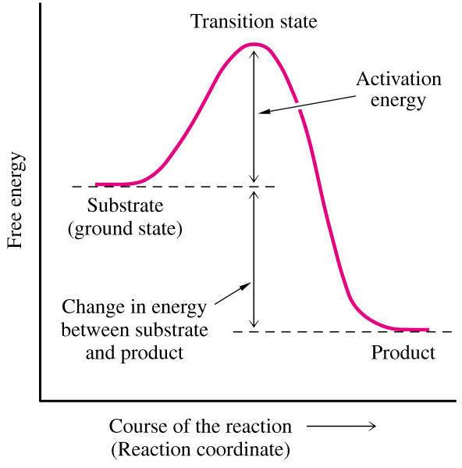
Transition State & Intermediate
Rate of reaction depends on the frequency at which reactants collide and form the Transition State (TS).
- Reactants must be in the correct orientation and collide with sufficient energy to form transition state.
The energy require to reach transition state from ground state is called Activation Energy.
- Activation energy barrier must be exceeded for reaction to proceed.
- Lower activation energy barrier result in more stable TS.
- The higher the TS, the more likely the reaction will proceed.

Slide 3
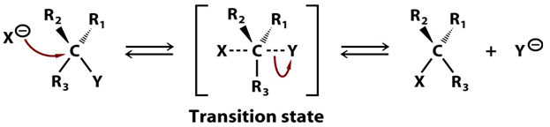
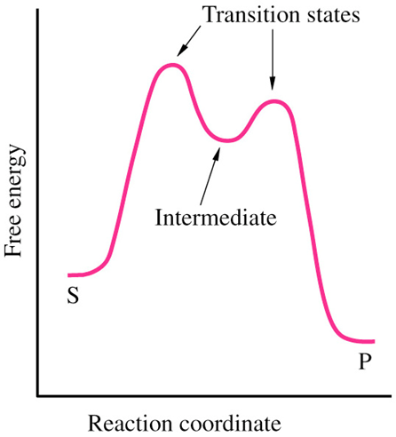
Transition State & Intermediate
Transition State is an unstable high-energy intermediate.
Bonds are in the process of being formed and broken in TS.
- Short lived (10^{–14} to 10⁻¹³ secs).
In reactions with intermediates, 2 transition states are involved.
- Intermediates are stable.
- Formation of intermediate during reaction is the slowest step.

Slide 4
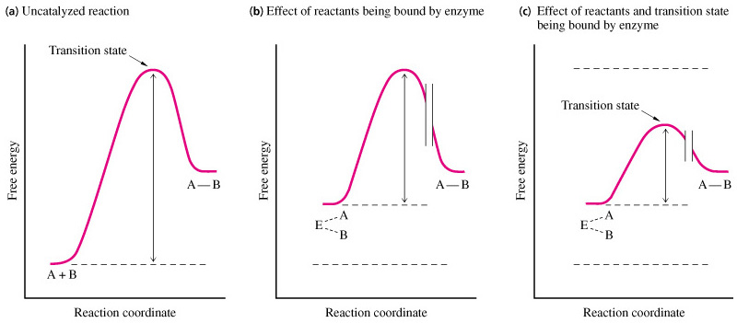
Transition State & Intermediate
Enzyme binding of substrates decrease activation energy by increasing the initial ground state (brings reactants together).
When TS binds to the active site, the activation energy is further lowered, resulting in a faster reaction.

Slide 5
Transition State & Intermediate
Why is energy required to reach transition state lower in the active site?
It is a magic pocket
(1) Stabilizes transition
+
(2) Expels water
CoE
(1)
(2)
(3) Reactive groups
(4)
-
(4) Positions coenzymes
(3)

Slide 6
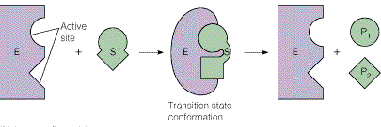
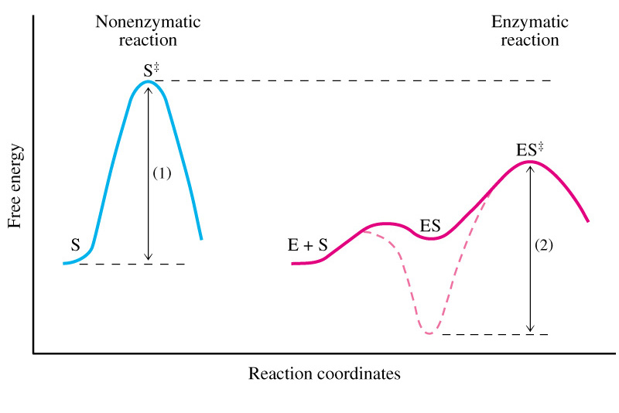
Enzymatic Catalysis
The first step in an enzymatic reaction is the formation of a noncovalent enzyme-substrate complex, ES.

Slide 7
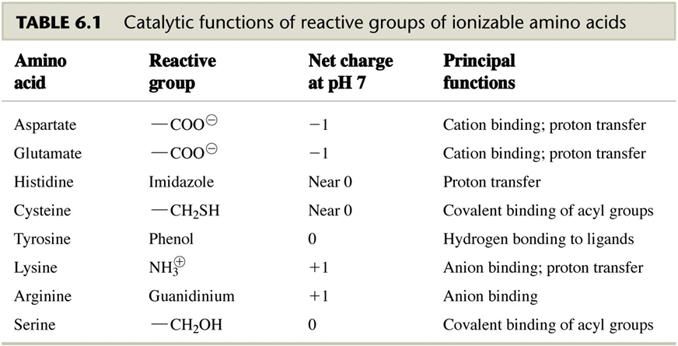
Chemical Modes of Enzymatic Catalysis
In biological reaction, formation of the ES complex places reactants close to reactive amino acid residues in the enzyme active sites.
These reactive amino acid residues in the enzyme active sites are often ionizable side chains.

Slide 8
Common Types of Enzymatic Mechanisms
There are many common types of enzymatic mechanisms:
1. Substitutions reactions.
2. Bond cleavage reactions.
3. Redox reactions.
4. Acid base catalysis.
5.Covalent catalysis.

Slide 9
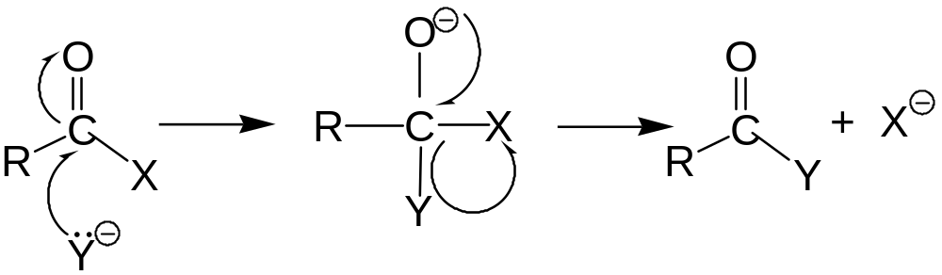
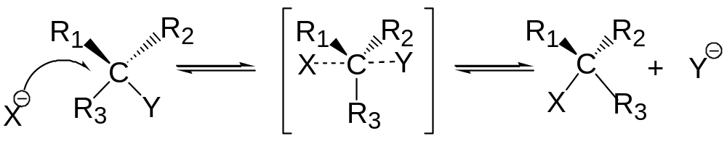
Common Types of Enzymatic Mechanisms
1. Substitutions reactions.
Nucleophillic Substitution.
Nucleophillic = e⁻ rich Electrophillic = e⁻ poor
Direct Substitution.
transition state

Slide 10

Common Types of Enzymatic Mechanisms
2. Bond cleavage reactions.
Heterolytic vs homolytic cleavage.
Carbanion formation (retains both e-)
Carbocation formation (lose both e-)
Free radical formation (lose single e-)

Slide 11
Common Types of Enzymatic Mechanisms
3. Oxidation reduction (Redox) Reactions.
Central to energy production.
Loose e- = oxidation (LEO).
- Oxidations = removal of hydrogen or addition of oxygen or removal of e-.
- If one atom/molecule is oxidized, another must be reduced (reducing agent donates e- to oxidizing agent).
Gain e- = reduction (GER).
In biological systems reducing agent is usually a co-factor (NADH of NADPH).

Slide 12
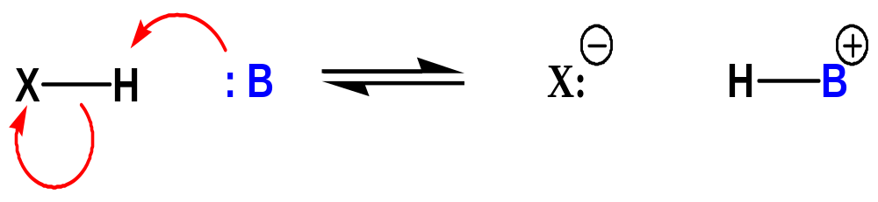
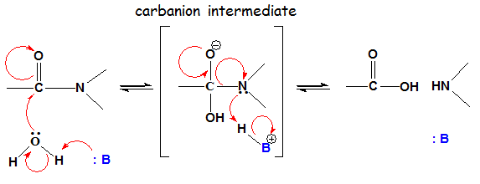
Common Types of Enzymatic Mechanisms
4. Acid base catalysis.
Accelerates reactions by catalytic transfer of a proton.
Involves amino acid residues that can accept a proton.
Can remove proton from –OH, -NH or -CH.
Creates a strong nucleophillic reactant.

Slide 13


Common Types of Enzymatic Mechanisms
5.Covalent catalysis.
20% of all enzymes employ covalent catalysis.
A group from a substrate binds covalently to enzyme.
The intermediate enzyme substrate complex (A-X) then donates the group (X) to a second .
i.e. Protein Kinases.

Slide 14
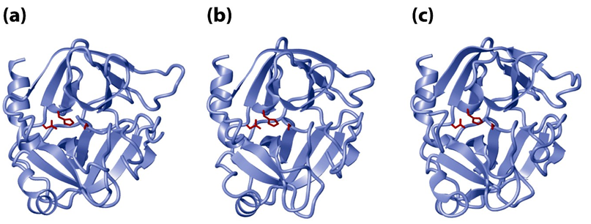
The Serine Proteases
A group of protease that involve a serine component in catalysis.
- i.e. Trypsin, chymotrypsin, elastase, thrombin, subtilisin, plasmin.
- All these serine proteases are structurally similar:
Chymotrypsin Trypsin Elastase

Slide 15
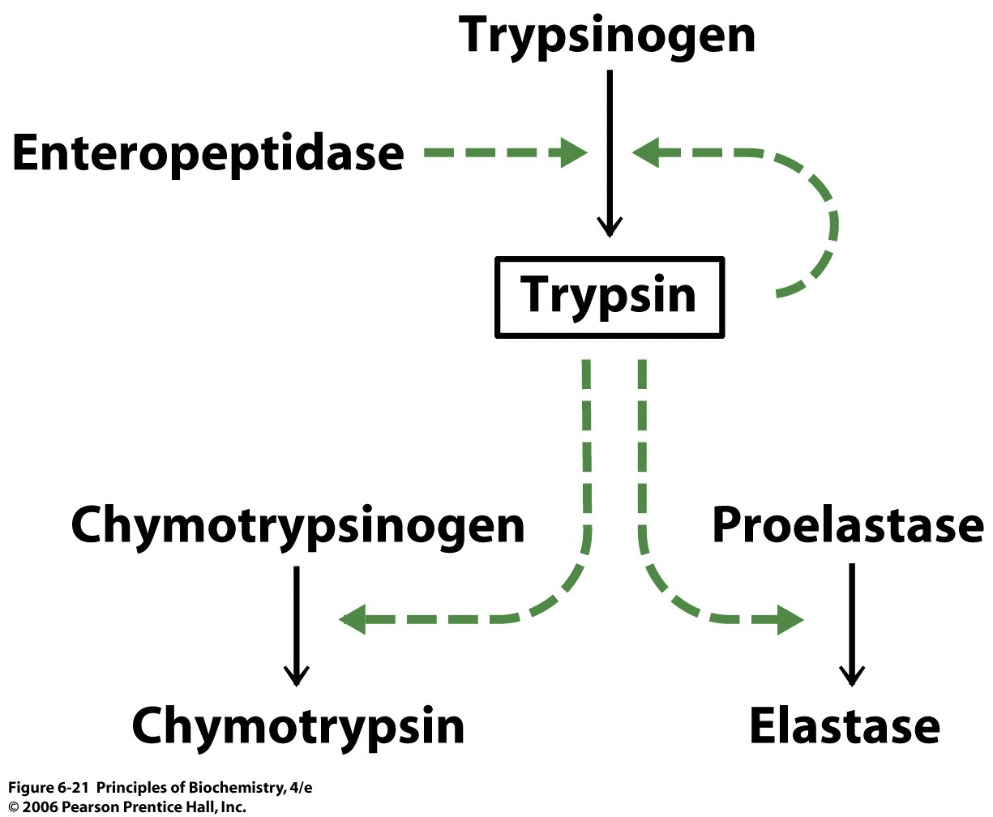
The Serine Proteases

Slide 16
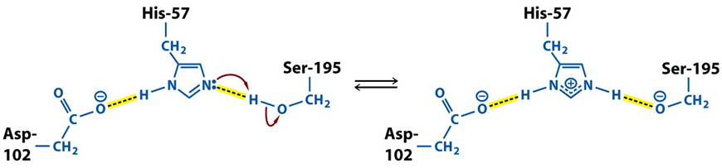
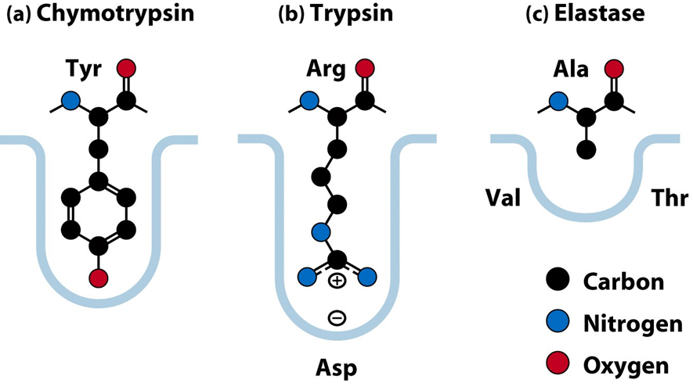
The Serine Proteases
Part of a "catalytic triad" of Ser, His, Asp.
Substrate specificity are determined by binding pocket.

Slide 17
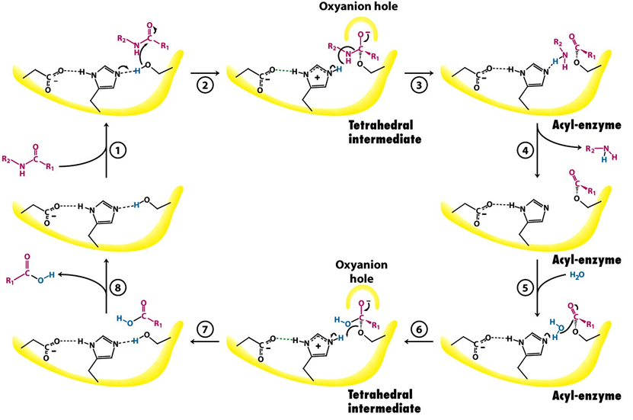
The Serine Proteases
Mechanism of Chymotrypsin-catalyzed of a peptide model (Page 188-189)

