Slide 1

STB1083 BIOCHEMISTRY
Lecture 7
ENZYMES KINETICS

Slide 2
Enzymes Kinetics
Enzyme kinetics is the study of the biological and chemical reactions that are catalysed by enzymes.
Determines number of steps involved and identifies “rate-limiting” step.
Provides information on enzyme specificities and mechanisms.
Several terminologies involved in the study of Enzyme Kinetics
Rate Constants & Reaction Order.
Initial Velocities
Steady State Assumption
Enzymes Inhibition

Slide 3
Rate Constants & Reaction Order
Rate constant (k) measures how rapidly a reaction (rxn) occurs.
k₁
A B + C
k₋₁
Zero order rxn (rate is independent of reactant concentration)
1st order rxn (rate dependent on concentration of 1 reactant)
v = k₁ [A]
- Rate (v, velocity) = (rate constant) (concentration of reactants)
2nd order rxn (rate dependent on concentration of 2 reactants)
v = k₋₁[B][C]

Slide 4
Rate Constants & Reaction Order
E
+
S
E
S
E
+
P
k₁
k₂
E + S ES E + P
k₋₁
k₋₂
E = free enzyme
S = substrate
ES = enzyme-substrate complex
P = product

Slide 5
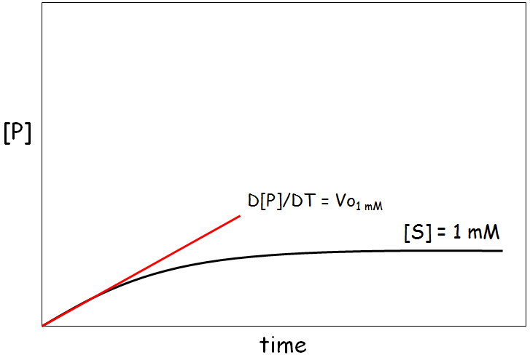
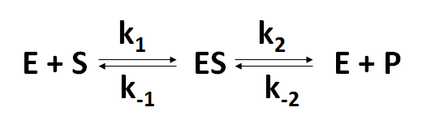

Initial Velocities
Measurements made to measure initial velocity (v_{o}). At v_{o} very little product (P) formed. The rate at which E + P react to form ES is negligible and k₋₂ is 0.

Slide 6
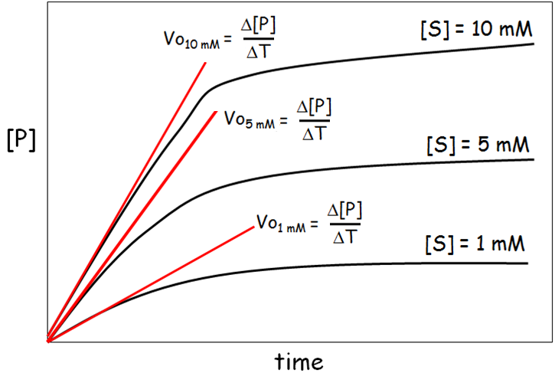
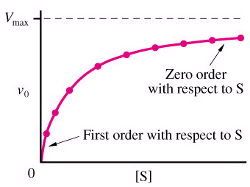
Initial Velocities
Measurements made to measure initial velocity (v_{o}). At v_{o} very little product (P) formed. The rate at which E + P react to form ES is negligible and k₋₂ is 0.
Plot V_{o} vs. [S]

Slide 7
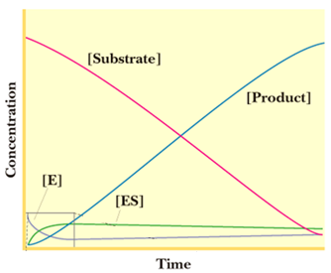
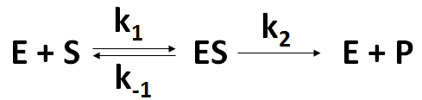
Steady State Assumption
Steady state assumption = [ES] is constant. The rate of ES formation equals the rate of ES breakdown.
The more ES present, the faster ES will dissociate into E + P or E + S.
Therefore, when the reaction is started by mixing enzymes and substrates, the [ES] builds up at first, but quickly reaches a STEADY STATE, in which [ES] remains constant.
Steady state
This steady state will persist until almost all of the substrate has been consumed.

Slide 8
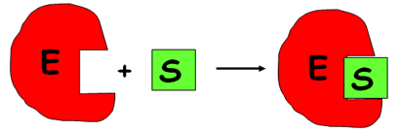
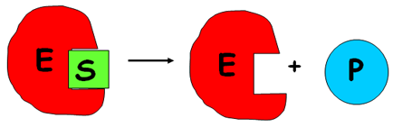
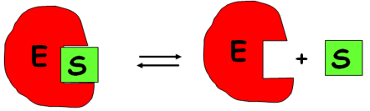
Steady State Assumption
Rate of ES formation:
k₁
E + S ES
Rate = k₁ [E] [S]
Rate of ES breakdown:
k₂
ES E + P
K₋₁
ES E + S
Rate = (k₂ [ES]) + (k₋₁[ES])
Rate = [ES](k₂ + k₋₁)

Slide 9

Steady State Assumption
Therefore, if the rate of ES formation equals the rate of ES breakdown.
k₁
k₂
E + S ES E + P
k₋₁
k₁[E][S] = [ES](k₋₁+ k₂)
(k₋₁+ k₂) / k₁ = [E][S] / [ES]
(k₋₁+ k₂) / k₁ = K_{m} (Michaelis constant)
Therefore, K_{m} = [E][S] / [ES]
By further solving this equation and using the necessary substitution, we will finally derive the Michaelis-Menten Equation.

Slide 10
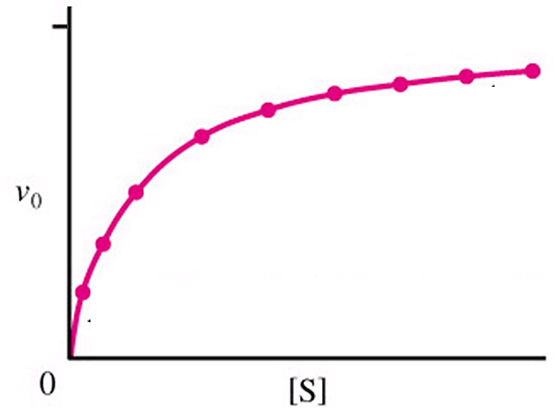
Michaelis-Menten Equation
In biochemistry, Michaelis–Menten kinetics is one of best-known models of enzyme kinetics.
Describes rectangular hyperbolic plot.

Slide 11
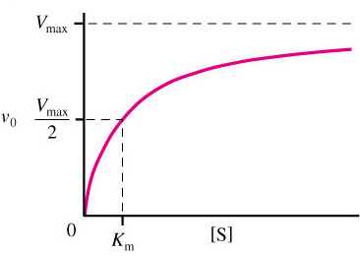
Michaelis-Menten Equation
V_{max} = velocity where all of the enzyme is bound to substrate
(enzyme is saturated with S)
V_{max}
K_{m}
k_{cat}
k_{cat}/K_{m}
Km = [S] @ ½ Vmax
(units moles/L=M)
(1/2 of enzyme bound to S)

Slide 12
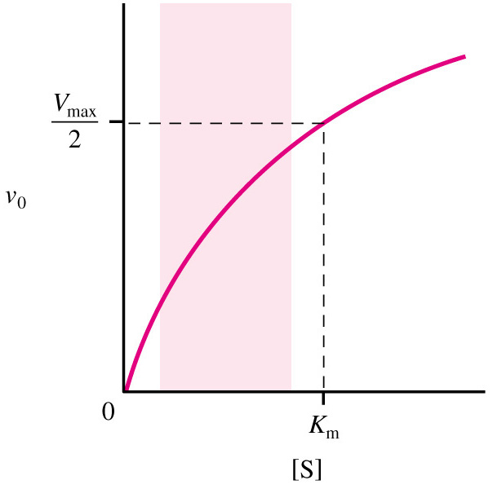
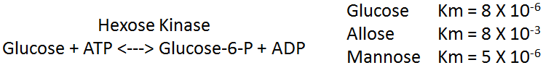
Michaelis-Menten Equation
What does K_{m} mean?
1. K_{m} = [S] at ½ V_{max}
2. K_{m} is a combination of rate constants describing the formation and breakdown of the ES complex.
3. K_{m} is usually a little higher than the physiological [S].
4. K_{m} represents the amount of substrate required to bind ½ of the available enzyme (binding constant of the enzyme for substrate).
5. K_{m} can be used to evaluate the specificity of an enzyme for a substrate (if obeys M-M).
6. Small K_{m} means tight binding; high K_{m} means weak binding.

Slide 13
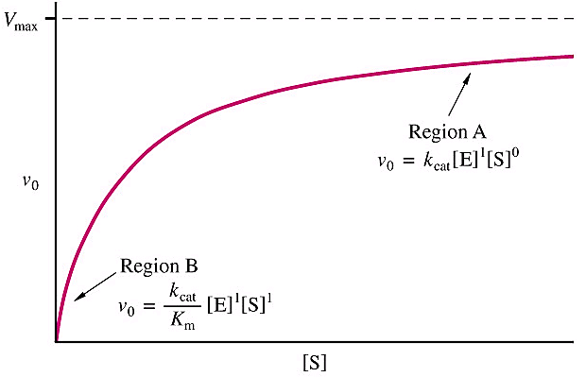
Michaelis-Menten Equation
What does K_{cat} mean?
1. k_{cat} is the 1st order rate constant describing ES → E+P.
2. Also known as the turnover number because it describes the number of reactions a molecule of enzyme can catalyze per second under optimal condition.
3. Most enzyme have k_{cat} values between 10² and 10³ s⁻¹.
4. For simple reactions, k₂ = k_{cat}.
5. For multistep reactions
k_{cat} = rate limiting step.
k₁
k_{cat}
E + S ES E + P
k₋₁

Slide 14
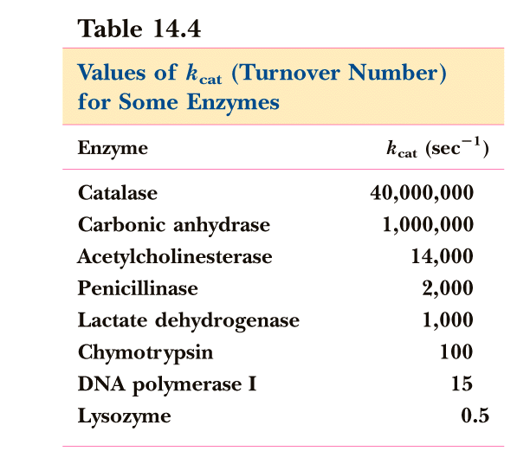
Michaelis-Menten Equation
What does K_{cat} mean?

Slide 15

Michaelis-Menten Equation
What does K_{cat}/ K_{m} mean?
1. It measures how the enzyme performs when S is low.
2. k_{cat}/K_{m} describes an enzymes preference for different substrates = specificity constant.
3. The upper limit for k_{cat}/K_{m} is the diffusion limit - the rate at which E and S diffuse together (10⁸ to 10⁹ M⁻¹ s⁻¹).
4. Catalytic perfection when k_{cat}/K_{m} = diffusion rate.
5. More physiological than k_{cat}.

Slide 16
Michaelis-Menten Equation
How do you get values for V_{max}, K_{m} and k_{cat}?
1. K_{m} and V_{max} can be determined experimentally.
- K_{m} can be determined without an absolutely pure enzyme.
2. K_{cat} values can be determined if V_{max} is known and the absolute concentration of enzyme is known (V_{max} = k_{cat}[E_{total}])

Slide 17
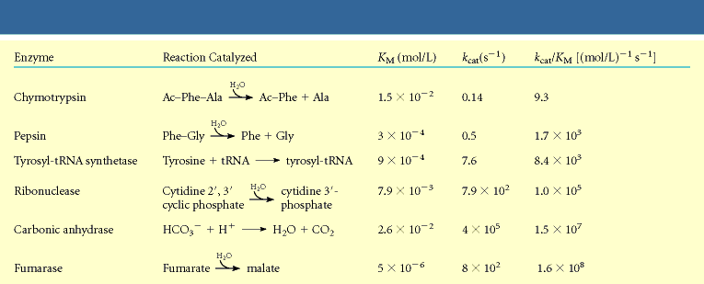
Michaelis-Menten Equation

Slide 18
Michaelis-Menten Equation
Limitations of Michaelis-Menton Equation:
1. Some enzyme catalyzed reactions show more complex behavior.
E + S <---> ES <---> EZ <---> EP <---> E + P
With Michaelis-Menten can look only at rate limiting step.
2. Often more than one substrate
E+S₁ <--> ES₁+S₂ <--> ES₁S₂ <--> EP₁P₂ <--> EP₂+P₁ <--> E+P₂
Must optimize one substrate then calculate kinetic parameters for the other.
3. Assumes k₋₂ = 0.
4. Assumes steady state conditions.

Slide 19
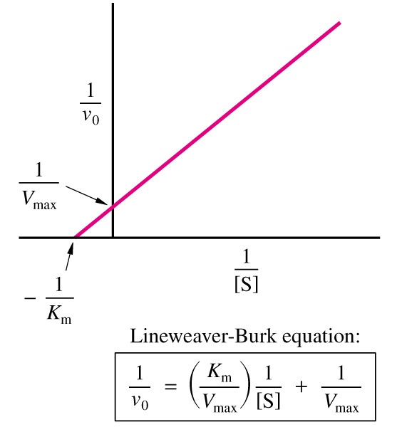
Lineweaver-Burke Plots (Double Reciprocal Plots)
Easier to extrapolate values with straight line vs hyperbolic curve.
The rectangular hyperbolic plot of the Michaelis-Menten Equation can be simplified into a linear plot.
Plot 1/[S] vs 1/V_{o}
L-B equation for straight line.
X-intercept = -1/K_{m}
Y-intercept = 1/V_{max}

Slide 20
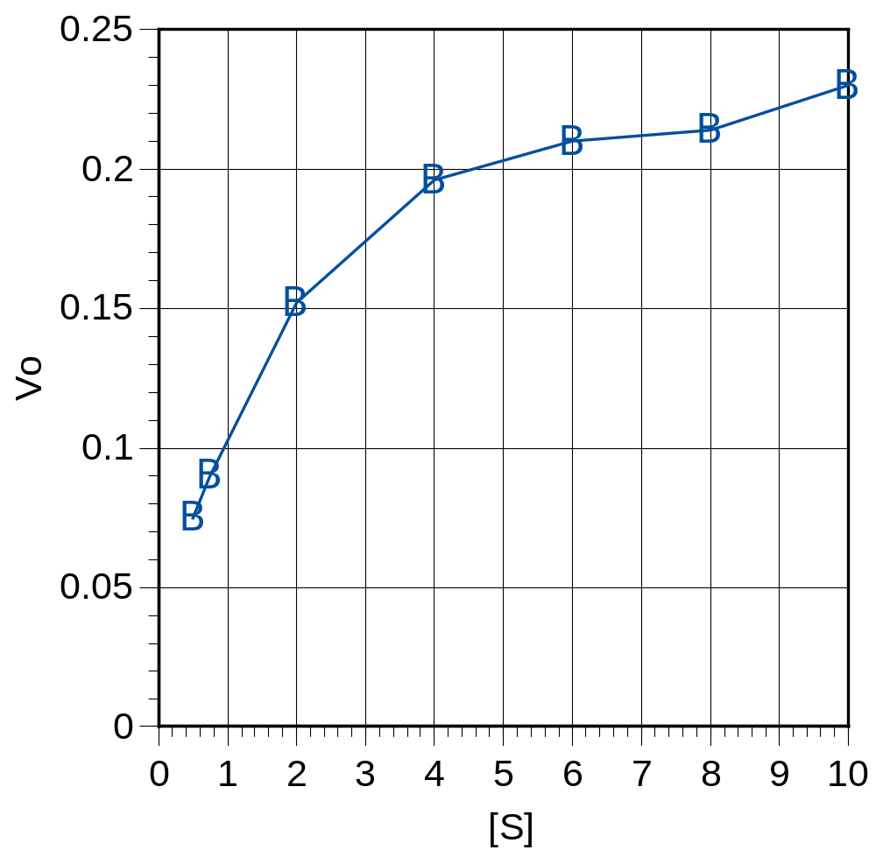
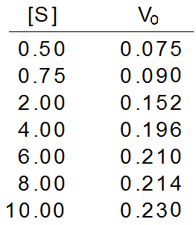
Lineweaver-Burke Plots (Double Reciprocal Plots)
V_{max}
K_{m}
V_{max} = 0.24
K_{m} = 1.2 mM

Slide 21
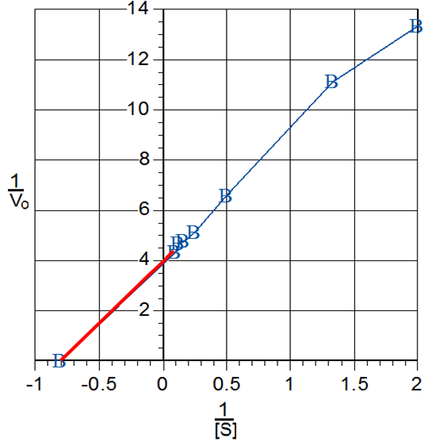
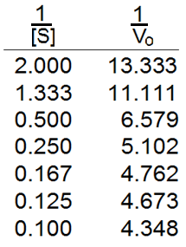
Lineweaver-Burke Plots (Double Reciprocal Plots)
-1/K_{m} = - 0.8
K_{m} = 1.25 mM
1/V_{max} = 4.0
V_{max} = 0.25

Slide 22
Enzyme Inhibition
Inhibitor – substance that binds to an enzyme and interferes with its activity.
Can prevent formation of ES complex or prevent ES breakdown to E + P.
E + S ES E + P
E + I EI
K_{i} = [E][I]/[EI]
Two types of inhibitors.
1. Reversible Inhibitors.
- Reversible Inhibitors bind through non-covalent interactions (disassociates from enzyme).
2. Irreversible inhibitors.
- Irreversible inhibitor binds to enzyme through covalent bonds (binds irreversibly).

Slide 23
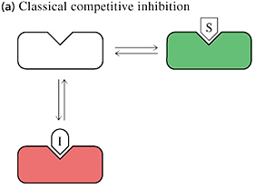
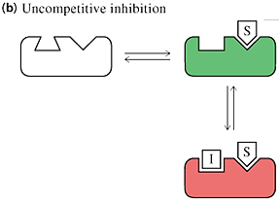
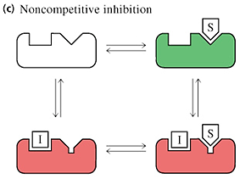
Enzyme Inhibition - Reversible Inhibitor
Types of Reversible Enzyme Inhibitors.
1. Competitive.
2. Uncompetitive.
3. Non-competitive.

Slide 24
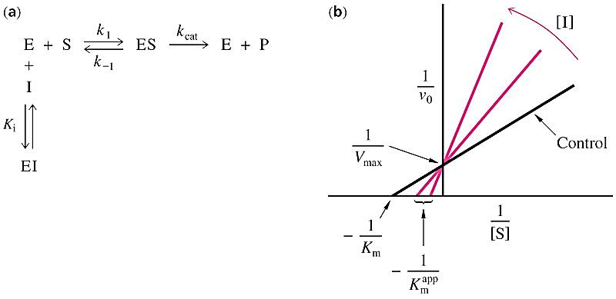
Enzyme Inhibition - Reversible Inhibitor
1. Competitive Inhibitors (CI).
CI binds free enzyme.
Competes with substrate for enzyme binding.
Raises K_{m} without effecting V_{max}.
Can relieve inhibition with more S.

Slide 25
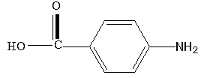
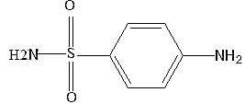
Enzyme Inhibition - Reversible Inhibitor
1. Competitive Inhibitors (CI).
Competitive Inhibitors look like substrate.
Example: PABA and Sulfanilamide.
PABA
Sulfanilamide
- PABA precursor to folic acid in bacteria.

Slide 26
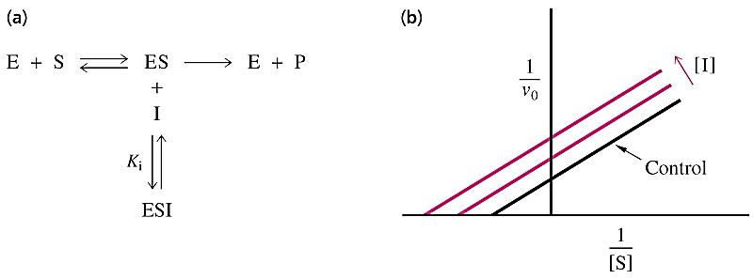
Enzyme Inhibition - Reversible Inhibitor
2. Uncompetitive Inhibitors (UI).
UI binds ES complex.
Prevents ES from proceeding to E + P or back to E + S.
Lowers K_{m} & V_{max}, but ratio of K_{m}/V_{max} remains the same.
Occurs with multisubstrate enzymes.

Slide 27
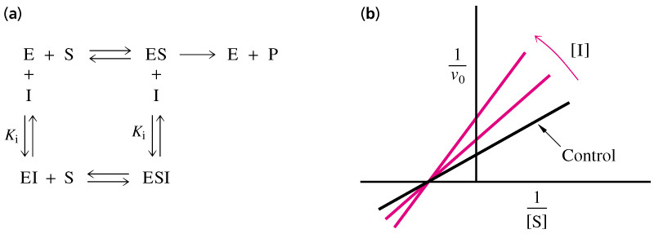
Enzyme Inhibition - Reversible Inhibitor
3. Non-competitive Inhibitors (NI).
NI can bind free E or ES complex.
Lowers V_{max}, but K_{m} remains the same.
NI’s don’t bind to S binding site, therefore don’t effect K_{m}.
Alters conformation of enzyme to effect catalysis but not substrate binding.

Slide 28
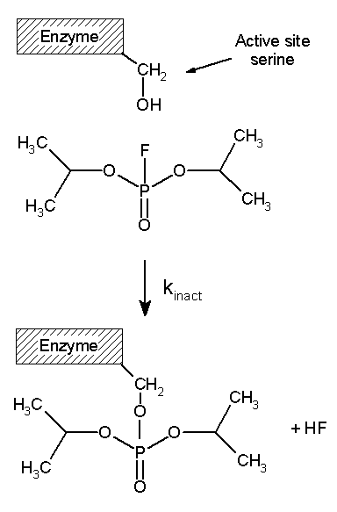
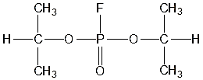
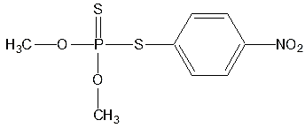
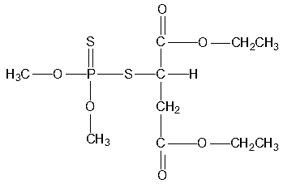
Enzyme Inhibition - Irreversible Inhibitor
Examples:
Organophosphates.
- Inhibit serine hydrolases.
Diisopropyl fluorophosphate
(nerve gas)
parathion
malathion

Slide 29
Kinetics of Multisubstrate Reactions
E + A + B <-----> E + P + Q
Several possible reactions:
1. Sequential Reaction
- Ordered
- Random
2. Ping Pong Reactions.

Slide 30
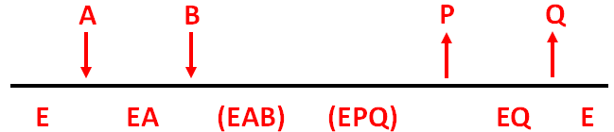
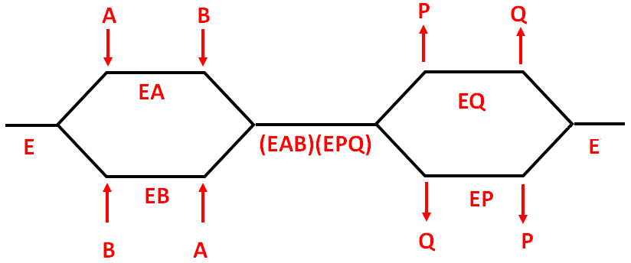
Kinetics of Multisubstrate Reactions
1. Sequential Reaction
- Ordered
- Random

Slide 31
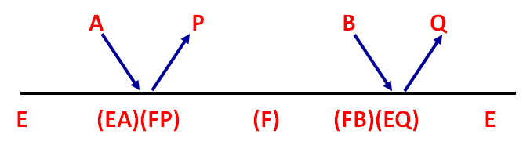
Kinetics of Multisubstrate Reactions
2. Ping Pong Reaction
In Ping-Pong reactions, one substrate bind first to the enzyme followed by product P release.
Typically, product P is a fragment of the original substrate A.
The rest of the substrate is covalently attached to the enzyme E, which we now designate as F.
Now the second reactant, B, binds and reacts with the enzyme to form a covalent adduct with the covalent fragment of A still attached to the enzyme to form product Q.
This is now released and the enzyme is restored to its initial form, E.

