Slide 1

STB1083 BIOCHEMISTRY
Lecture 5
PROTEINS

Slide 2
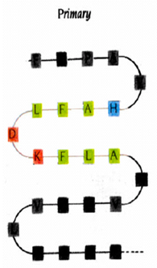

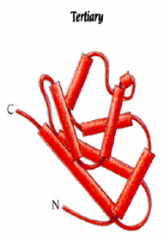
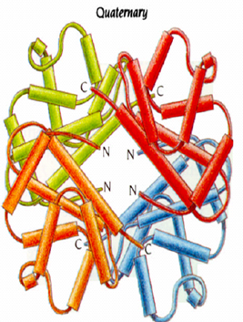
Protein Structure
Several level of protein structure
1. Primary structure – sequence of amino acid.
2. Secondary structure – local structure.
3. Tertiary structure – overall 3D shape of protein.
4. Quarternary structure – subunit organization.

Slide 3
Protein Structure
All of the information necessary for folding the peptide chain into its native structure is contained in the primary amino acid structure of the peptide.
The forces that determine protein structure:
- Primary structure → covalent bonds.
- Secondary, tertiary and quarternary structure → all determined by weak forces.

Slide 4
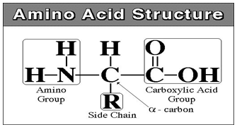
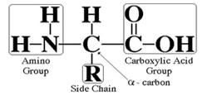
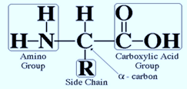
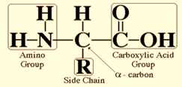

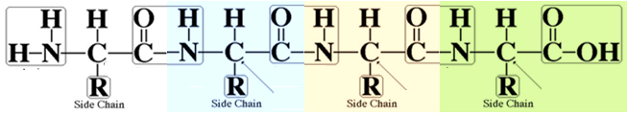
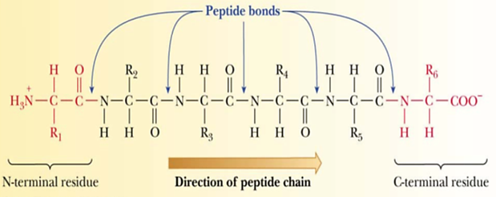
Protein Structure – Primary Structure
H₂0
H₂0
H₂0

Slide 5


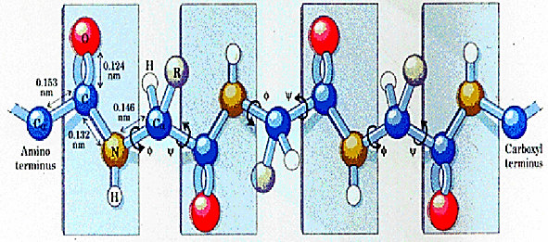
Protein Structure – Secondary Structure

Slide 6

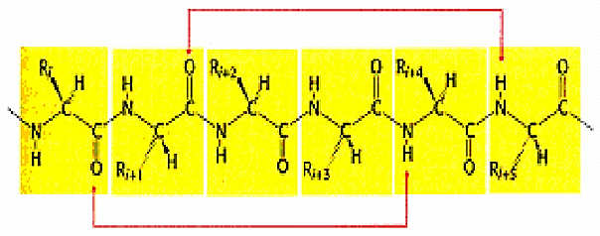
Secondary Structure – Alpha Helix

Slide 7


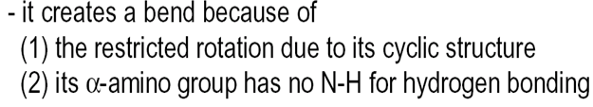
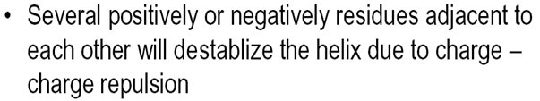
Secondary Structure – Alpha Helix

Slide 8

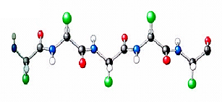

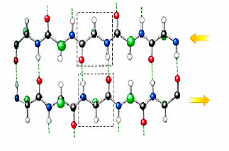


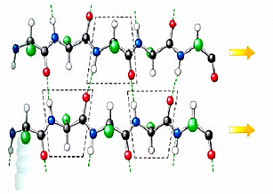



Secondary Structure – Beta Sheets

Slide 9
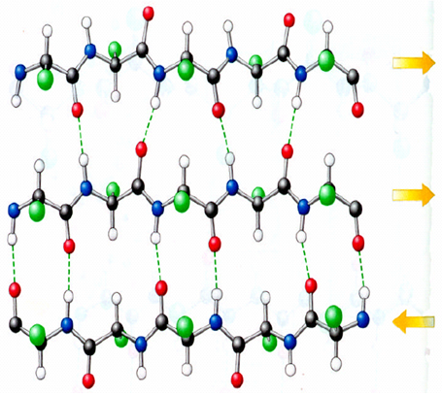
Secondary Structure – Large Beta Sheets

Slide 10
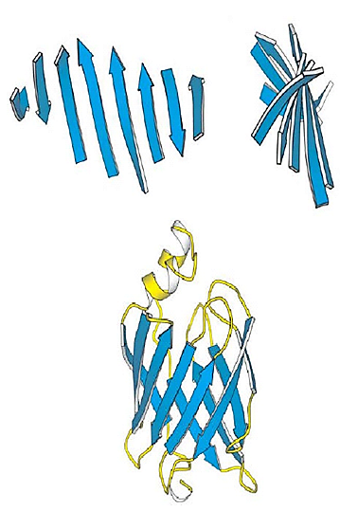


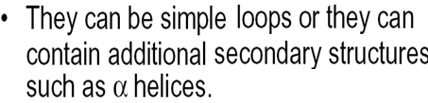
Secondary Structure – Large Beta Sheets

Slide 11
Secondary Structure – Large Beta Sheets

Slide 12

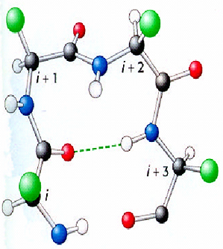
Secondary Structure – β Turns and Loops

Slide 13
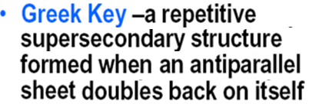
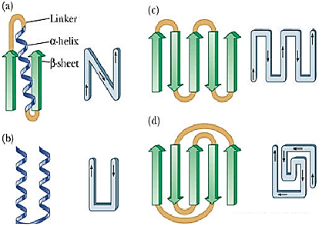
SuperSecondary Structure

Slide 14
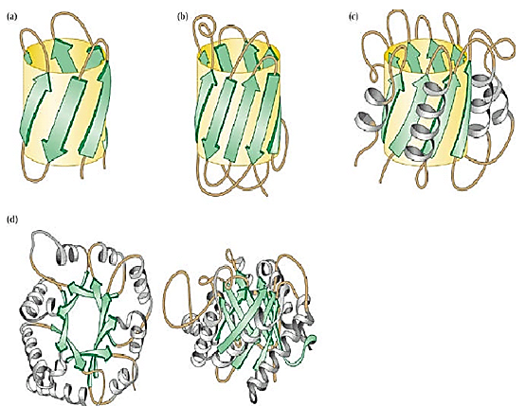
Secondary Structure – Motifs

Slide 15


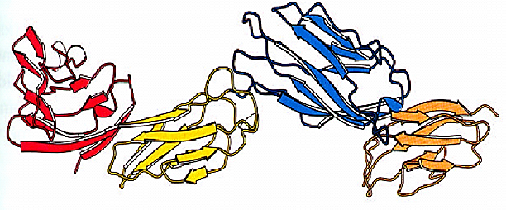
Secondary Structure – Domains

Slide 16
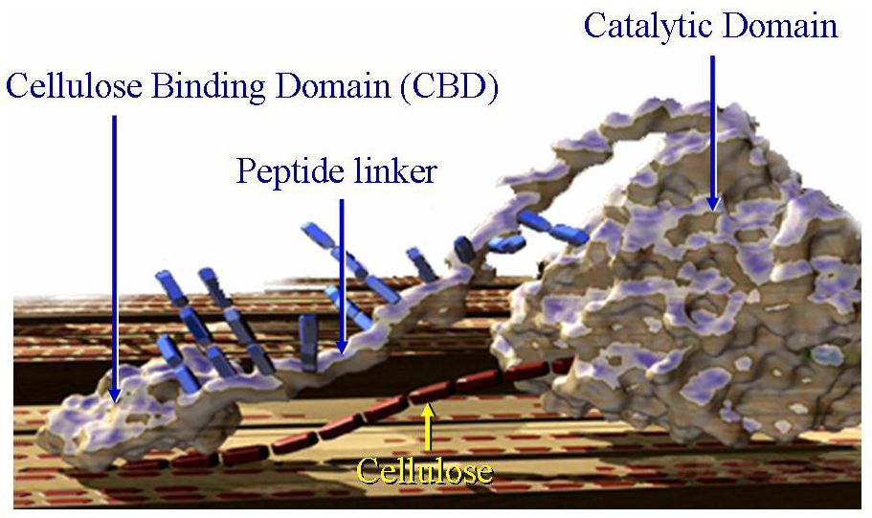
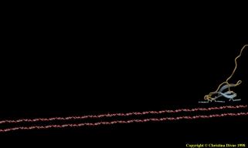
Secondary Structure – Domains

Slide 17


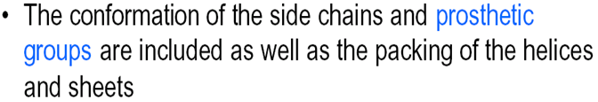
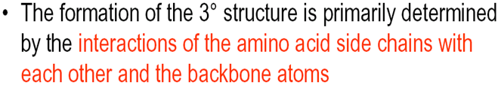
Tertiary Structure
2 examples of tertiary structures – fibrous or globular.

Slide 18


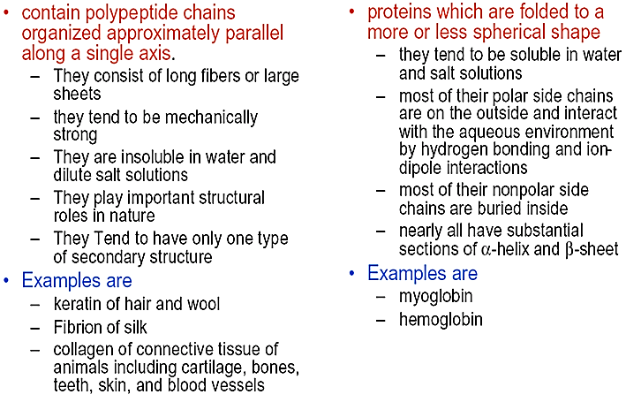
Tertiary Structure – Fibrous vs. Globular Proteins

Slide 19

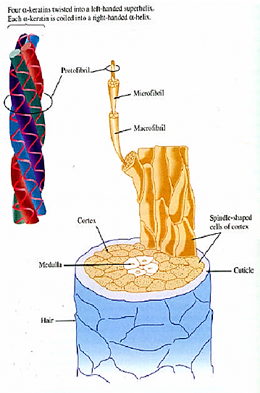



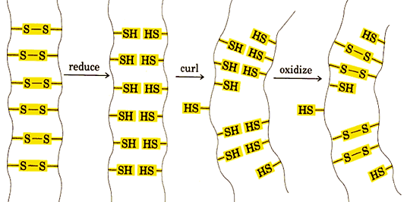
Tertiary Structure – Fibrous Proteins (α Keratin)

Slide 20

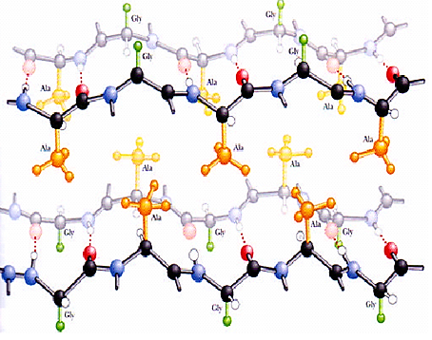
Tertiary Structure – Fibrous Proteins (Silk Fibrion)

Slide 21
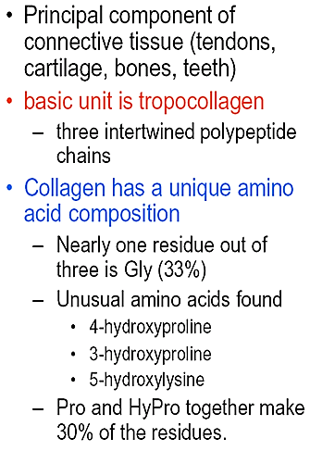
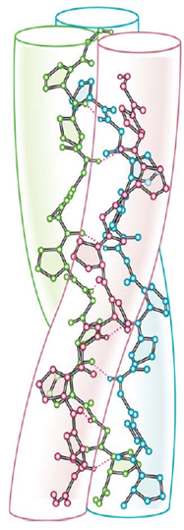
Tertiary Structure – Fibrous Proteins (Collagen)

Slide 22
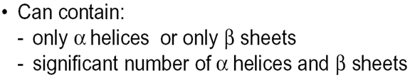
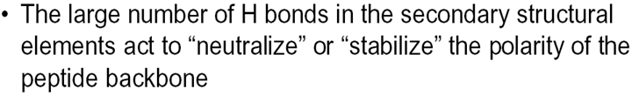
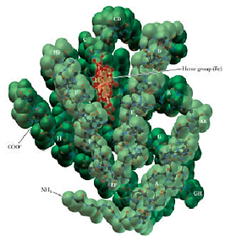
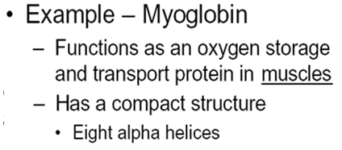
Tertiary Structure – Globular Proteins

Slide 23

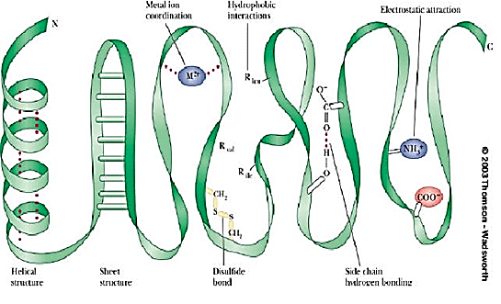
Tertiary Structure – Globular Proteins

Slide 24


Quartenary Structure

Slide 25
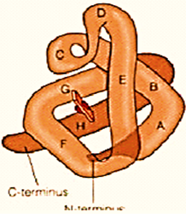
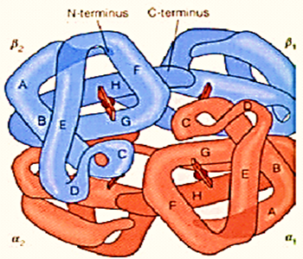


Quartenary Structure

Slide 26
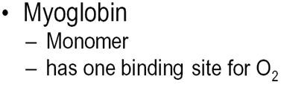

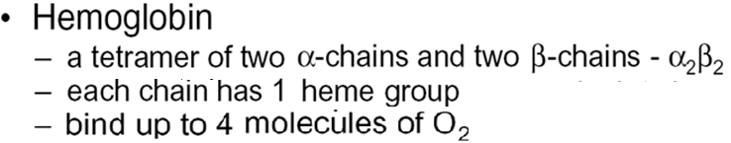

Quartenary Structure

