Slide 1

STB1083 BIOCHEMISTRY
Lecture 3
ACID AND BASES

Slide 2
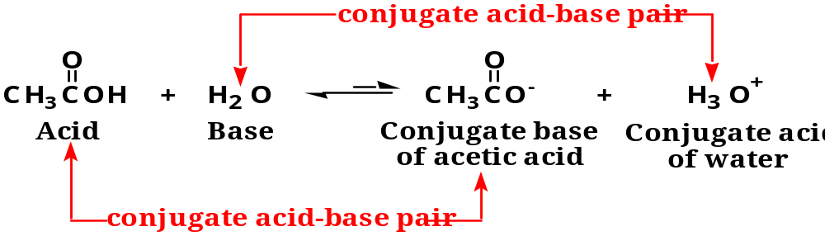
Weak Acids and Weak Bases
Strong acids or strong bases are compounds that is completely ionized in aqueous solution (i.e. HCl, H₂SO₄, NaOH & KOH).
Weak Acids or Weak Bases are compounds that are incompletely ionized in aqueous solution (i.e. Phosphoric Acid H₃PO₄ and Carbonic Acid H₂CO₃).
- Example:

Slide 3
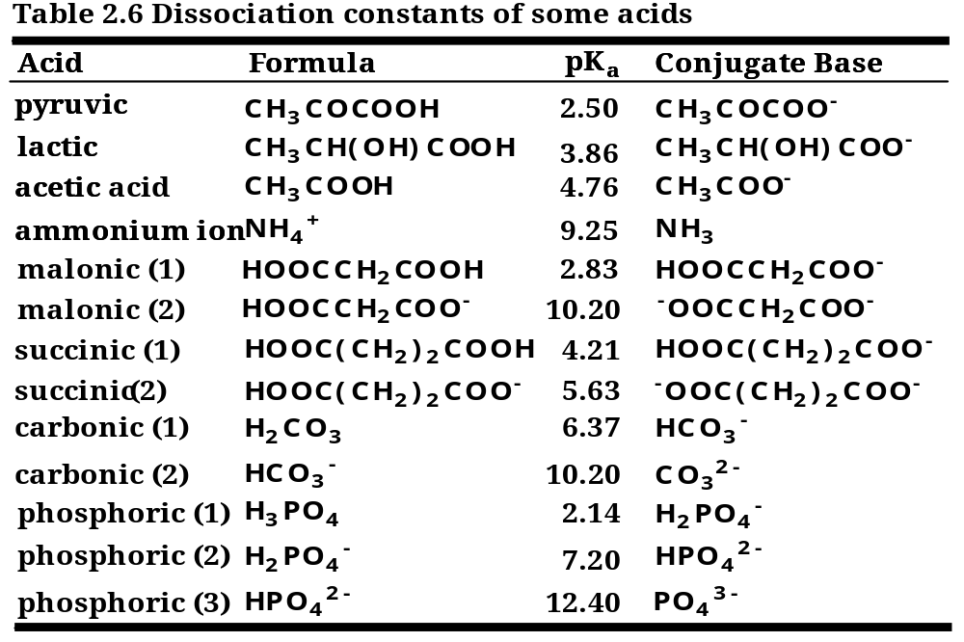
Weak Acids and Weak Bases
Examples of weak acids and weak bases.

Slide 4
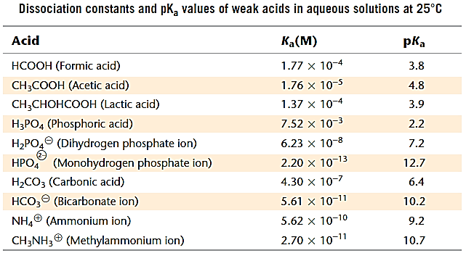
Weak Acids and Weak Bases

Slide 5
Weak Acids and Weak Bases
In biochemistry or the living biological systems, weak acids are more often encountered compared to weak bases.
Many biomolecules such as amino acids, purines and pyrimidines are weak acids that do not dissociate completely in water.
The pH of blood and cells are also maintained by biological buffers that are weak acids:
- H₂PO₄⁻/HPO₄²⁻ is the principal buffer in cells.
- H₂CO₃/HCO₃⁻ is an important buffer in blood.

Slide 6

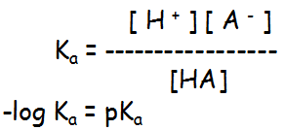
Weak Acids and Weak Bases
Weak acids only partially dissociate.
K_{a} is the ionization constant for a weak acid, HA, in water.

Slide 7






Henderson – Hasselbalch Relationships
The Henderson–Hasselbalch equation is used to determine the final pH of a weak acid solution once the dissociation reaction reaches equilibrium.
The smaller the pK_{a} (disassociation constant), the more acidic the weak acid.

Slide 8
Henderson – Hasselbalch Relationships
From this equation, we see that:
- When the [deprotonated] = [protonated], pH = pK_{a}
- When pH < pK_{a}, “H⁺ on” or substance protonated.
- When pH > pK_{a}, “H⁺ off” or substance deprotonated.

Slide 9
Henderson – Hasselbalch Relationships
Example:
Calculate the pH of a mixture of 0.1 M acetic acid and 0.2 M
sodium acetate. (The pK_{a} of acetic is 4.76).
CH₃COOH CH₃COO⁻ + H⁺
pH = pKa + log
[CH₃COO⁻]
[CH₃COOH]
pH = pKa + log
[0.2]
[0.1]
pH = 4.76 + 0.301
pH = 5.06

Slide 10
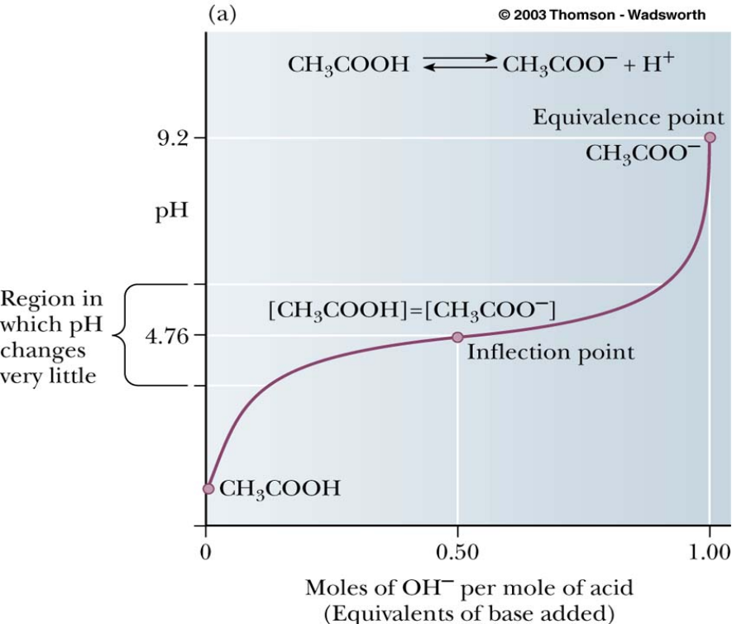

Titration Curves
The pKa value is determined via Titration.
Titration - an experiment in which measured amounts of base (or acid) are added to measure amounts of acid (or base).
Inflection point - the point in an acid-base titration at which enough base has been added to neutralize the 50 % of the acid (or vice versa).
End or Equivalence point - the point in an acid-base titration at which enough base has been added to exactly neutralize the acid (or vice versa).

Slide 11
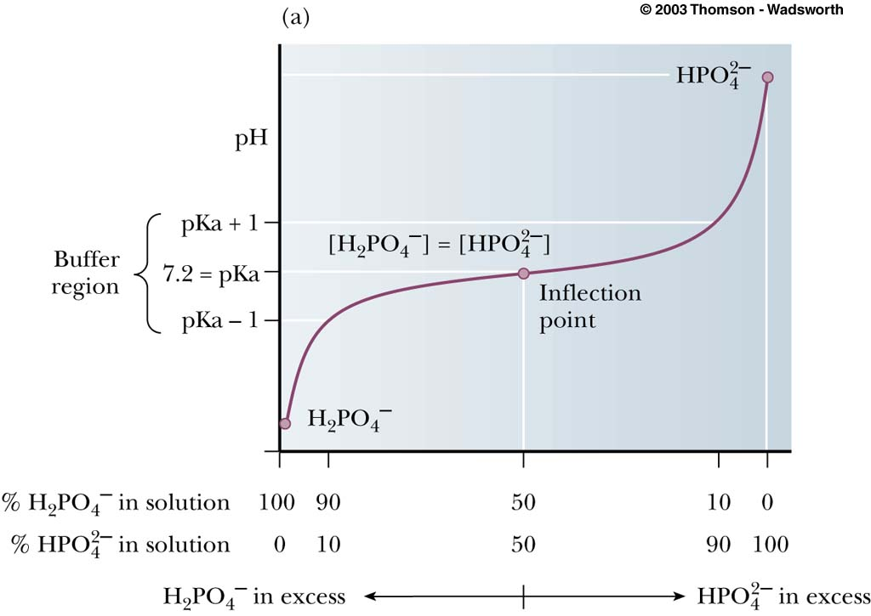
Titration Curves

Slide 12
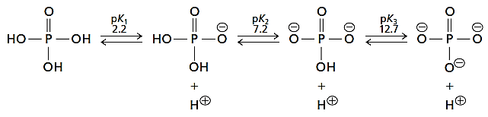
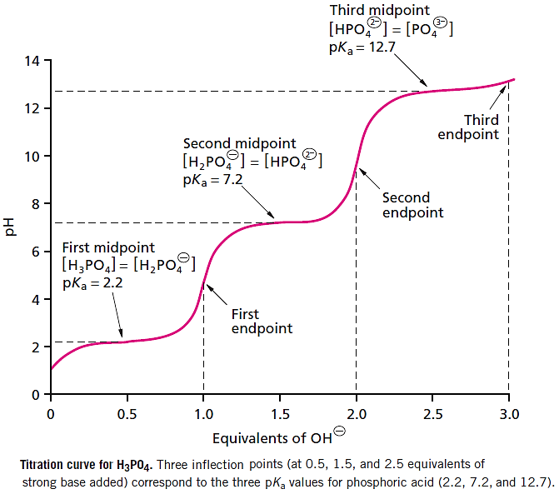
Titration Curves

Slide 13
Buffered Solutions
Buffered solution are solutions that resist changes in pH as acid and base are added.
The ability of a solution to resist changes in pH is known as its buffer capacity.
Buffer capacity is related to the concentrations of the weak acid and its conjugate base.
- The greater the concentration of the weak acid and its conjugate base, the greater the buffer capacity.
- The most effective buffering region occurs when the the pH equals the pKa.
- The effective range of buffering is usually one pH unit below to one pH unit above the pKa.
Most buffers consist of a weak acid and its conjugate base.
- i.e. Acetate buffer (pKa = 4.76) and Phosphate buffer (pKa = 7.20).

Slide 14
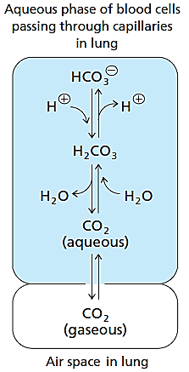
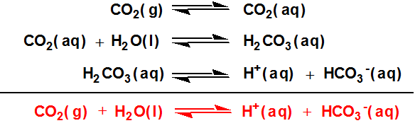
Biological Systems are Buffered
The two main buffers in biological systems are carbonic (H₂CO₃/HCO₃⁻) and phosphoric (H₂PO₄⁻/HPO₄²⁻) buffers.
- H₂CO₃/HCO₃⁻ is an important buffer in blood.
→The pH of blood (~pH 7.45) is primarily regulated by the carbon dioxide–carbonic acid–bicarbonate buffer system.
→At pH 7.45, the major components in the buffer are carbonic acid and the bicarbonate anion (HCO₃⁻).
→Hypoventilation can result in decreased blood pH.
→Hyperventilation can result in increased blood pH.

Slide 15
Biological Systems are Buffered
The two main buffers in biological systems are phosphoric (H₂PO₄⁻/HPO₄²⁻) and carbonic buffers (H₂CO₃/HCO₃⁻).
- H₂PO₄⁻/HPO₄²⁻ is the principal buffer in cells.
→Within cells, both proteins and inorganic phosphate contribute to intracellular buffering.
→Hemoglobin is the strongest buffer in blood cells other than the carbon dioxide–carbonic acid–bicarbonate buffer.
→The major species of inorganic phosphate present at physiological pH are H₂PO₄ and HPO₄, reflecting the second pKa (pK2) value for phosphoric acid, pH 7.2.

