Slide 1

STB1083 BIOCHEMISTRY
Lecture 2
WATER and HYDROGEN BONDS

Slide 2
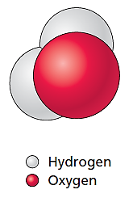
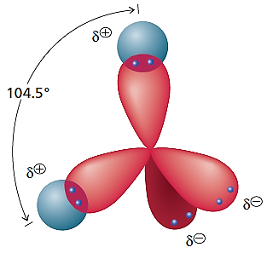
Water
Water is the most abundant molecule in most cells, accounting for 60% to 90% of the mass of the cell.
Mammalian cells consist of approximately 70% water.
2/3 of our water is inside our cells,
1/3 is outside our cells.
A water molecule (H₂O) is V-shaped.
The H—O—H bond angle in free water molecules is 104.5°.
- If the electron orbitals were really pointing to the four corners of a tetrahedron, the angle would be 109.5°.
- Strong repulsion between the lone electron pairs pushes the covalent bond orbitals closer to reduce the angle to 104.5°.
- Some important properties of water arise from its angled shape and the intermolecular bonds that it can form.

Slide 3
Water
Why is water important?
1. Water is the solvent for various biological systems.
Most metabolic processes of cells has to operate in an aqueous environment because water is an essential solvent.
i. Many molecules interact extensively with water and, as a result, are very soluble.
Polar compounds.
Non-ionic polar compounds dissolve in water because of the dipole–dipole interactions.
Ionic compounds.
Ionic compounds readily dissolve in water because of the ionic – dipole interactions.

Slide 4
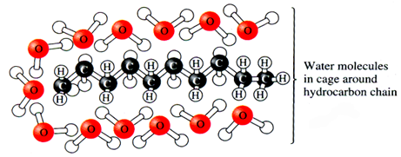
Water
Why is water important?
1. Water is the solvent for various biological systems.
Most metabolic processes of cells has to operate in an aqueous environment because water is an essential solvent.
ii. Some molecules do not dissolve easily in water and tend to associate with each other in order to avoid water.
Non polar compounds.
The H-bond network of water reorganizes to accommodate the non-polar solute.
As a result, the non-polar substances tend to aggregate.

Slide 5
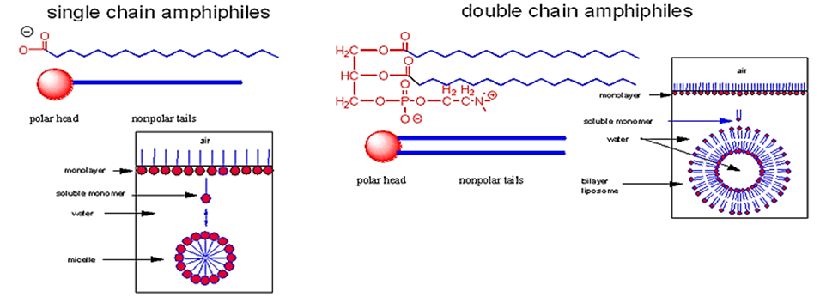
Water
Why is water important?
1. Water is the solvent for various biological systems.
Most metabolic processes of cells has to operate in an aqueous environment because water is an essential solvent.
iii. Other molecules contain both polar and non-polar groups.
Amphipathic compounds.

Slide 6
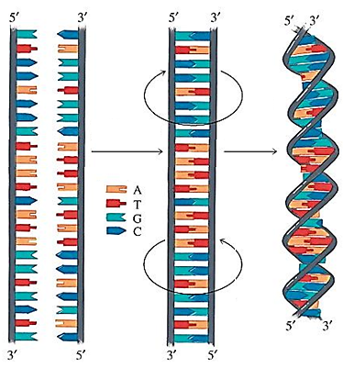
Water
Why is water important?
2. The macromolecular components of cells - proteins, polysaccharides, nucleic acids, and lipids - assume their characteristic shapes in response to water.
i.e. DNA
Hydrophillic sugar phosphate backbone winds around outside of helix.
Nitrogenous base-pairs are hydrophobic and faces the interior of the helix.
Hydrophobic environment makes H-bonding between bases stronger, causing the sugar-phosphate backbone to twist.

Slide 7
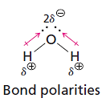

Water
Oxygen atoms are more electronegative than hydrogen atoms because an oxygen nucleus attracts electrons stronger than the single proton in the hydrogen nucleus.
Uneven distribution of charge occurs within each O-H bond of the water molecule with oxygen bearing a partial negative charge (δ-) and hydrogen bearing a partial positive charge (δ+).
This uneven distribution of charge within a bond is known as a dipole and the bond is said to be polar.
The angled arrangement of the polar O—H bonds of water creates a permanent dipole for water molecule.

Slide 8

Water
The polarity of water molecules causes its molecules to attract one another.
The attraction between one of the positive hydrogen atoms and the negative electron pairs produces a hydrogen bond.
About 20 kJ mol^{–1} of heat is given off when hydrogen-bonded water molecules form under standard conditions.
- Therefore, +20 kJ mol^{–1} of heat energy is required to disrupt hydrogen bonds between water molecules.
- To break a covalent O-H bond in water, 460 kJ mol^{–1} is needed, to break a covalent C-H bond 410 kJ mol^{–1} is needed.
- Thus, hydrogen bonds are weak interactions compared to covalent bonds.

Slide 9
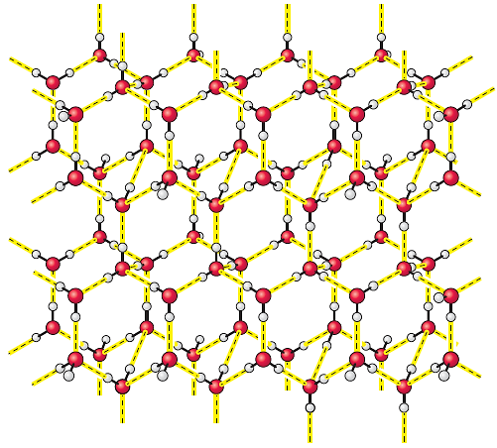
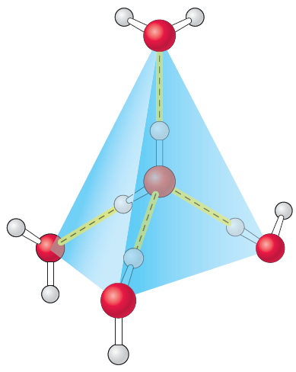
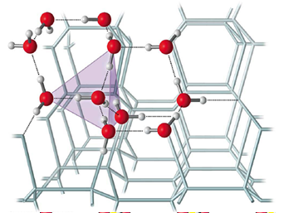
Water
Water is a network of molecules.
Water molecules are unusual because they can form four O-H-O aligned hydrogen bonds with up to four other water molecules when in solid phase (ice).
Each of the hydrogen bonds points to the oxygen atom of an adjacent water molecule, forming a tetrahedron.
Freezing causes the "net" to become a rigid tetrahedral lattice.
Melting releases some of the lattice and water molecules move closer together.
- Makes liquid water denser than solid, therefore ice floats.

Slide 10
Water
Liquid water molecules usually only form two or three bonds at any given moment.
This is a dynamic structure.
The average hydrogen bond lifetime in water is only 10 picoseconds (10⁻¹¹ s).
Two additional properties of water are related to its hydrogen-bonding characteristics - specific heat and heat of vaporization.
Large amount of heat is required to raise temperature of water because multiple hydrogen bonds that must be broken to release water molecules.
The abundance of water in the cells and tissues means that temperature fluctuations within cells are minimized.

Slide 11
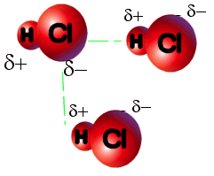
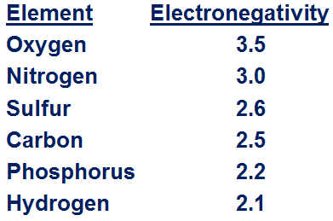
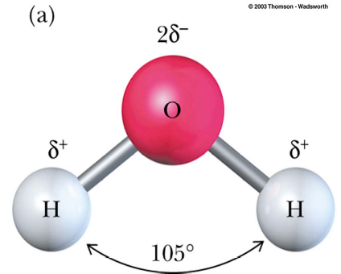
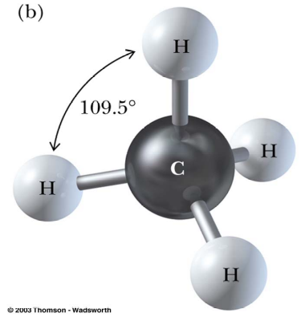
Polar vs. Nonpolar
Polar – unequal sharing of electrons.
Electronegativity – tendency to attract electrons.
Water is polar because:
Difference in electronegativity between O-H bent structure – non-linear
Methane is non-polar because:
Little difference in electronegativity between C-H tetrahedral bond angles

Slide 12
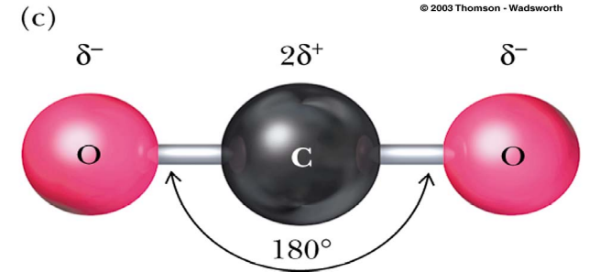
Polar vs. Nonpolar
Polar bonds but non-polar compound because:
Linear Structure – equal and opposite attractions.

Slide 13
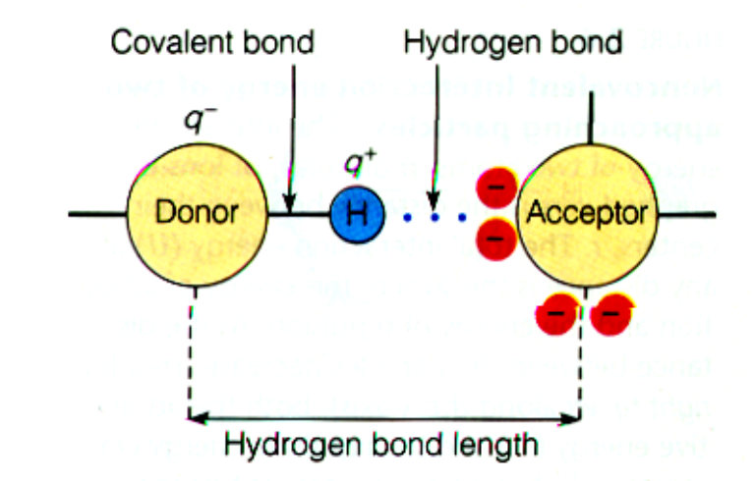
Hydrogen Bonds
Hydrogen bonding is one of the most important interactions in biological molecules.
Hydrogen bonding is an interaction between a covalently bonded hydrogen atom in a donor group and a pair of non-covalent electrons on an acceptor group.
The ability of a group to act as a hydrogen bond donor depends on its electronegativity.
- Generally, in biological systems, only O and N have sufficient electronegativity.

Slide 14
Hydrogen Bonds
Hydrogen bonding is one of the most important interactions in biological molecules.
Hydrogen bonding is an interaction between a covalently bonded hydrogen atom in a donor group and a pair of non-covalent electrons on an acceptor group.
The ability of a group to act as a hydrogen bond donor depends on its electronegativity.
- Generally, in biological systems, only O and N have sufficient electronegativity.

Slide 15
Hydrogen Bonds
Hydrogen bonds is very important and has many unique property:
1. Forms H bonds with itself and other molecules.
2. Tetrahedral shape.
3. Stronger than other non-covalent bonds.
4. Most specific of non-covalent interactions.
5. Responsible for thermal properties.
6. Both a H bond acceptor and donor.

Slide 16
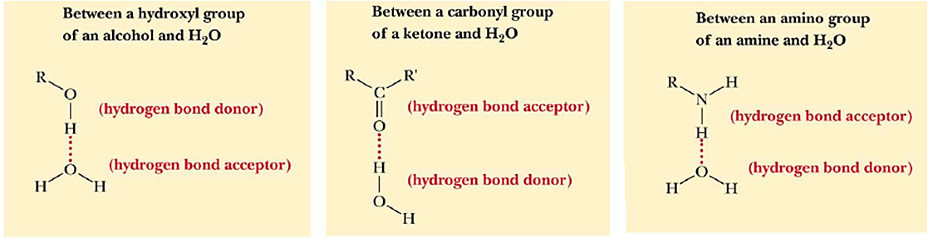
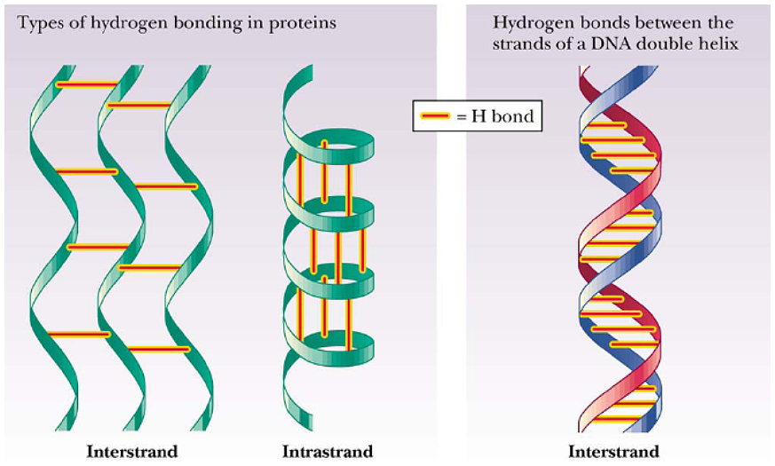
Hydrogen Bonds
Examples of biologically relevant hydrogen bonds.

Slide 17
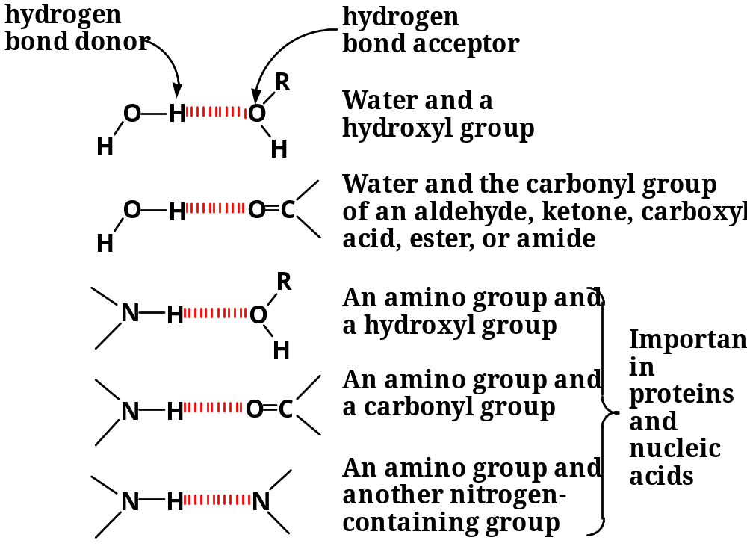
Hydrogen Bonds
Examples of biologically relevant hydrogen bonds.

Slide 18
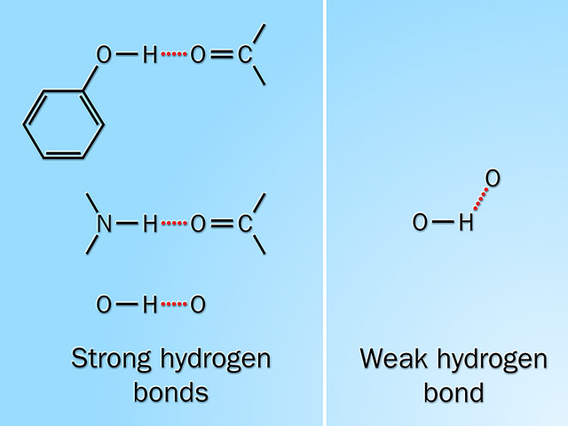
Strong and Weak Hydrogen Bonds
The strongest hydrogen bonds have the donor atom and the acceptor atom 180º apart.
Non-linear hydrogen bonds are weaker.

Slide 19
Non – covalent Bonds or Forces
Hydrogens bonds are not the only forces that shape biomolecules.
The 3-D structures of most macromolecules are results of the collective influence of the many weak individual interactions.
- Single interactions are typically not sufficient to hold two species/biomolecules together.
- Size, shape and type of interaction must also be correct for binding.
Other non-covalent bonds that determine the complexity of molecular interactions:
1. Hydrophobic Interactions.
2. Charge–Charge Interactions.
3. Electrostatic interaction.
4. Van der Waals Forces.

Slide 20
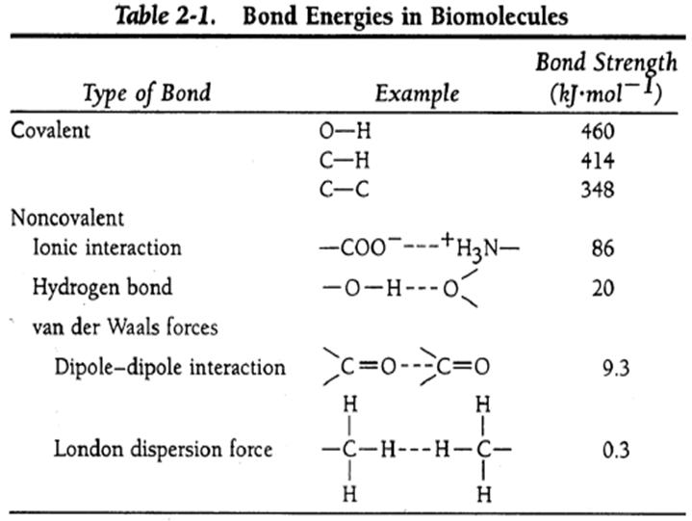
Non – covalent Bonds or Forces
Several properties of non-covalent bonds include.
- Non-covalent bonds are reversible.
- Non-covalent interactions are specific.
- Non-covalent bonds are 10 –100 times weaker than covalent bonds.

